Slide 1
Classification Decision Trees
Vera Hollink
2025

Slide 2

Summary last class

Slide 3
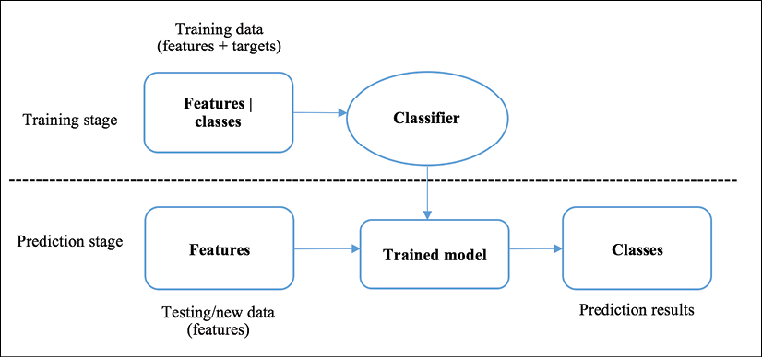
Classification
Binary classification
Multiclass/multinominal classification
Multilabel classification

Slide 4
Example: customers k = 3
= Buy
= No buy
New customer
Neighbors
age
IIncome

Slide 5
How to measure the distance?
Euclidean distance (numerical features)
Manhattan distance (numerical features)
Hamming distance (nominal features)
$$d(i,j)=\sqrt{(|x_{i1}−x_{j1}|^{2}+|x_{i2}−x_{j2}|^{2}+...+|x_{ip}−x_{jp}|^{2})}$$
$$d(i,j)=|x_{i1}−x_{j1}|+|x_{i2}−x_{j2}|+...+|x_{ip}−x_{jp}|$$
$$d\left(i,j\right)=Dx_{i1}x_{j1}+Dx_{i2}x_{j2}+…+Dx_{ip}x_{jp}$$
$$Dx_{ik}x_{jk}=0 if x_{ik}{=x}_{jk} Dx_{ik}x_{jk}=1 if x_{ik}{≠x}_{jk}$$

Slide 6

Decision trees

Slide 7
can fly
yes
no
legs
lays eggs
http://www.run.montefiore.ulg.ac.be/~francois/software/jaDTi/example/files/zooDT.png
< 6
≥ 6
yes
no
bird
no bird
cover
no bird
feathers
other
bird
no bird

Slide 8
Example: decision tree induction
Recordnr | Python | Math | English | Graduated
1 | Pass | Pass | Pass | Yes
2 | Fail | Fail | Fail | Yes
3 | Fail | Fail | Pass | No
4 | Fail | Fail | Fail | Yes
5 | Pass | Pass | Pass | Yes
6 | Fail | Pass | Fail | No
7 | Pass | Fail | Fail | Yes
8 | Fail | Pass | Fail | No
Create a decision tree to predict Graduated based on Python, Math, and English.

Slide 9
Algorithm for Decision Tree Induction
Algorithm: greedy, top-down, recursive
Steps
all the training examples at the root
select an attribute
examples are partitioned based on selected attribute
for each branch: go to step 2
Stopping conditions (create leaf)
All samples at a node are from the same class
There are no samples left
There are no attributes left: majority voting
9

Slide 10
Which attribute to select in each step?
can fly
lays eggs
no
yes
no
yes
legs
legs
< 6
≥ 6
< 4
≥ 4

Slide 11
Which attribute to select in each step?
Which splits can we make?
Binominal attribute yes / no
Multinominal attribute for each value in data set: =value / ≠value
Numerical attribute for each value in data set: < value / ≥ value many possible splits!
What makes a good tree?
Small tree: efficient and less overfitting
What makes a good split?
Split per class: all yes left, all no right

Slide 12
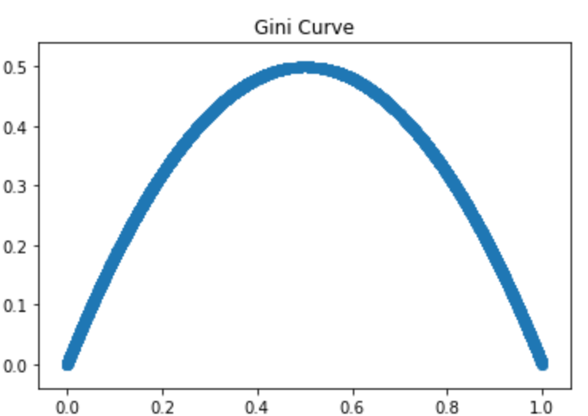
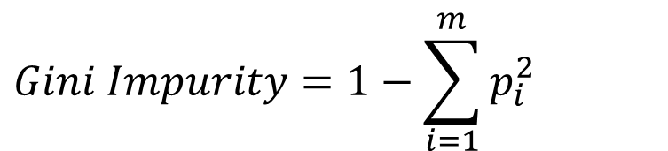
Attribute selection: Gini impurity
m classes with each fraction p_{i} of the data:
All samples in one class:
Gini impurity = 0
two classes 50/50
Gini impurity = 1-0.5²-0.5²=0.5
$$Gini Impurity=1−\sum_{i=1}^{m}{p_{i}^{2}}$$
Gini
Proportion class Yes

Slide 13
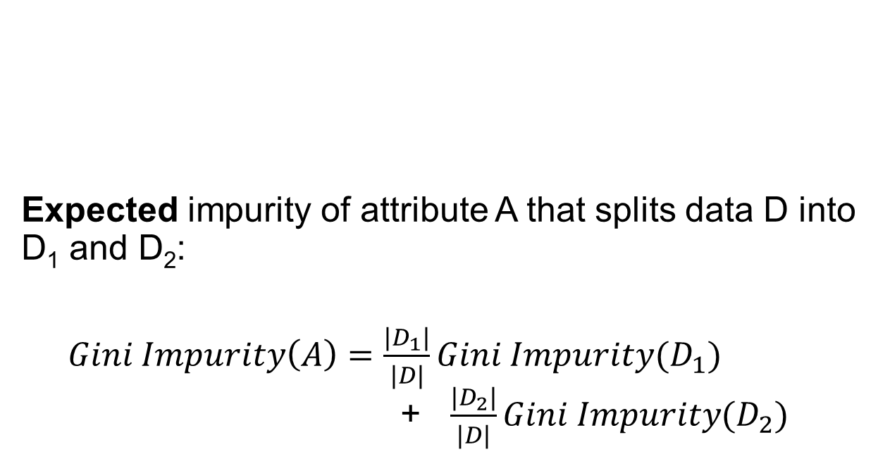
Attribute selection: Gini impurity
D
A
Expected impurity of attribute A that splits data D into D₁ and D₂:
$Gini Impurity\left(A\right)=\frac{|D_{1}|}{|D|}Gini Impurity(D_{1})$ + $\frac{|D_{2}|}{|D|}Gini Impurity(D_{2})$
yes
no
D₁
D₂

Slide 14
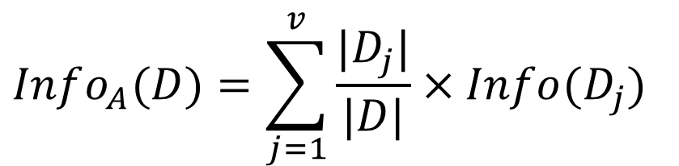
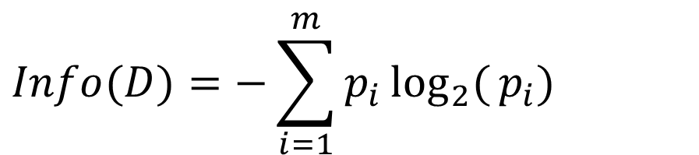
Attribute selection: Information gain
Information gain:
Information before split:
Expected information after split:
$$Gain(A)=Info(D)−Info_{A}(D)$$
$$Info(D)=−\sum_{i=1}^{m}{p_{i}}\log_{2}{(}p_{i})$$
$$Info_{A}(D)=\sum_{j=1}^{v}{\frac{|D_{j}|}{|D|}}×Info(D_{j})$$

Slide 15
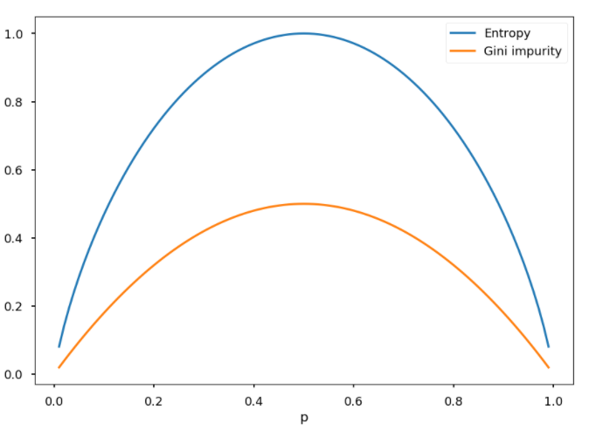
Attribute selection
Gini / information gain
Proportion class Yes

Slide 16
Exercise: compute Gini and information gain
StudentID | Python | Math | English | Graduated
4542 | Pass | Pass | Pass | Yes
4543 | Fail | Fail | Fail | Yes
4393 | Fail | Fail | Pass | No
4220 | Fail | Fail | Fail | Yes
4013 | Pass | Pass | Pass | Yes
4963 | Fail | Pass | Fail | No
4492 | Pass | Fail | Fail | Yes
4058 | Fail | Pass | Fail | No
Compute the Gini impurity and information gain of Python for predicting Graduated.

Slide 17

Avoiding an overly complex tree (overfitting) with pruning
Limit depth of the tree
max_depth = 4 Each branch has at most 4 attributes
Minimal number of samples per node
min_samples_split = 4 Don’t split if the node has less than 4 samples
min_samples_leaf = 4 Ensure that every leaf has at least 4 samples
If leaf node has samples from multiple classes: majority voting

Slide 18
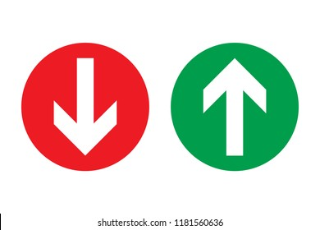
Pros and cons of decision trees
Advantages
Works well with nominal data
Model easy to explain
Disadvantages
Inefficient with numerical attributes

Slide 19
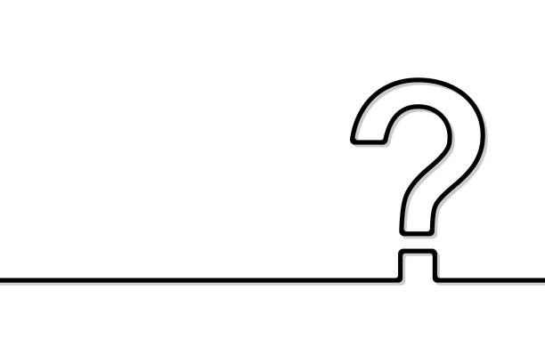
Questions?

Slide 20
And now…
Continue working on exercises part 3

